Slide 1
National Planning Framework 4
& Local Development Plan 2023
David Berry & Donna Laing
Senior Planners, Local Development Plan Team
LDP@aberdeencity.gov.uk

Slide 2
National Planning Framework 4 & LDP 2023
What we will cover
Context
  Former development plan system & National Planning Framework 3 (NPF3)
  Current development plan system & National Planning Framework 4 (NPF4)
NPF4 overview
  Overarching priorities
  Policies – range and level of detail
NPF4 and wider planning reforms
ALDP 2023
ALDP 2028

Slide 3

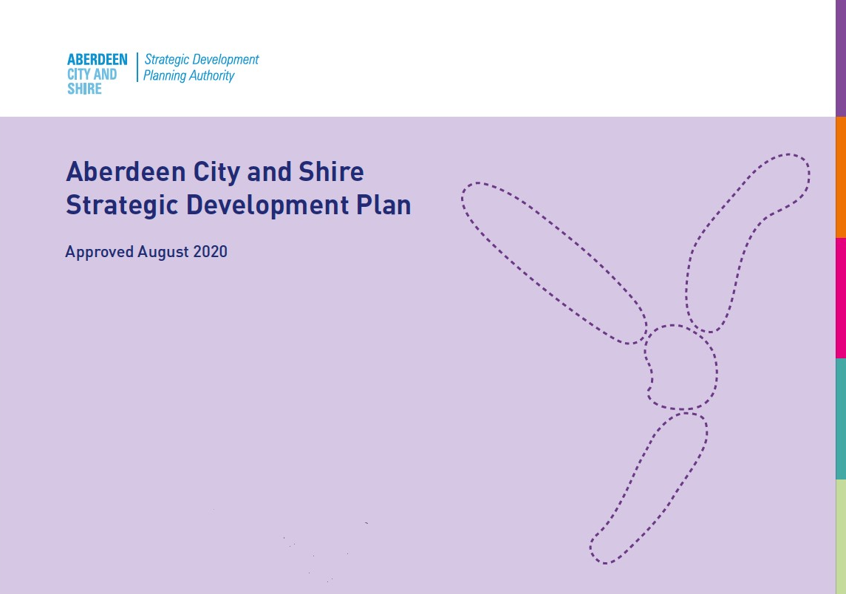
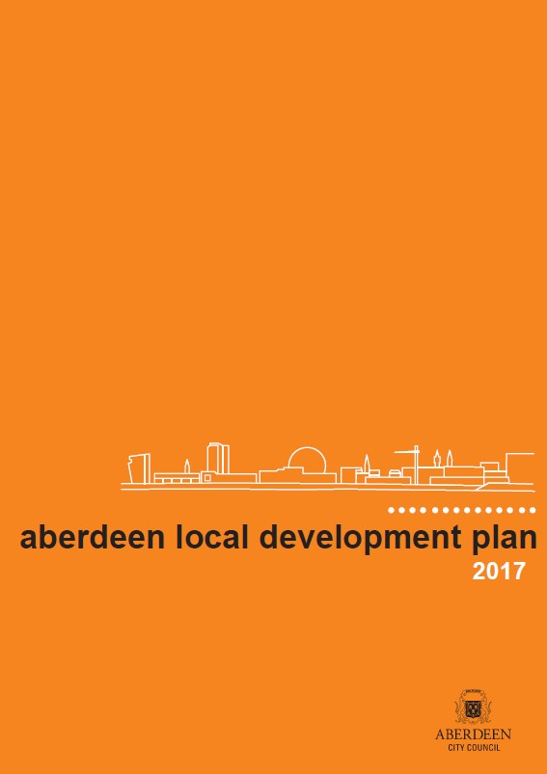

Former Development Plan System & NPF3
National
Regional
Local
Statutory ‘Development Plan’

Slide 4
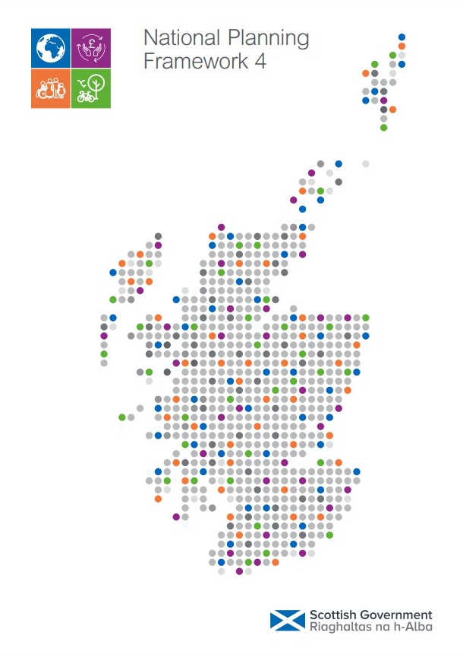
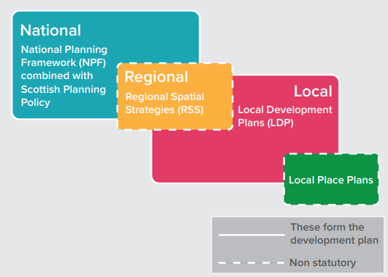
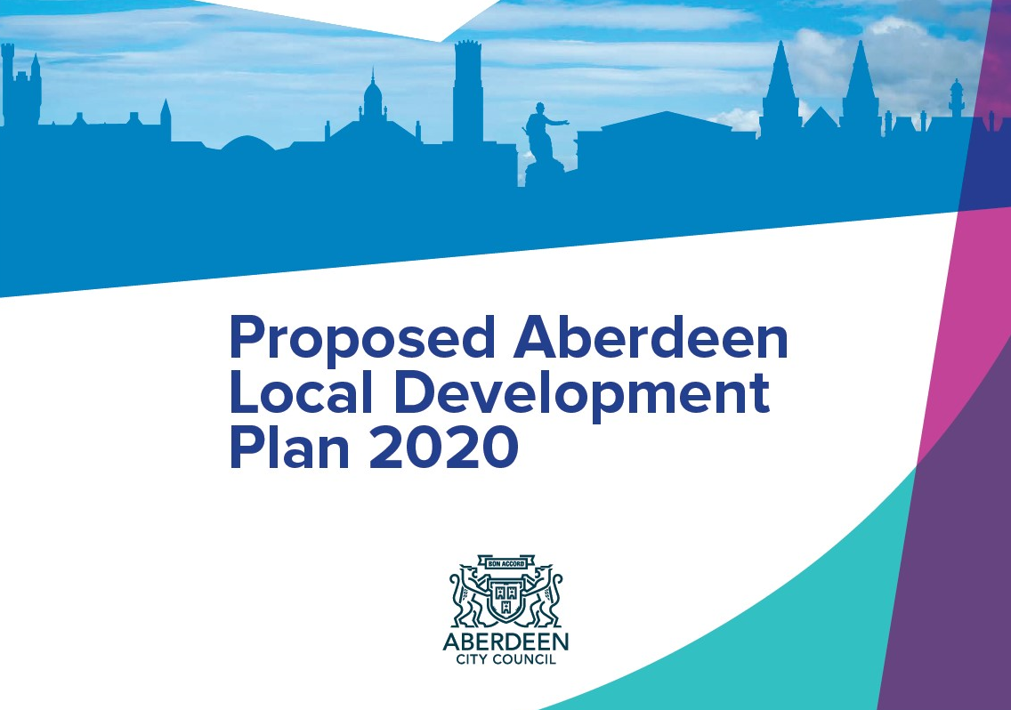
Current Development Plan System & NPF4
Adopted 13th Feb 2023
Adopted 19th June 2023

Slide 5
NPF4 Overview
Two main parts
  National Spatial Strategy for Scotland 2045
  National Planning Policy
National Spatial Strategy
  Climate and nature crises ‘front and centre’
  Three key themes
        sustainable places - where we reduce emissions, restore and better connect biodiversity
        liveable places - where we can all live better, healthier lives
        productive places - where we have a greener, fairer and more inclusive wellbeing economy
  Eighteen ‘national developments’ identified – six under each theme

Slide 6
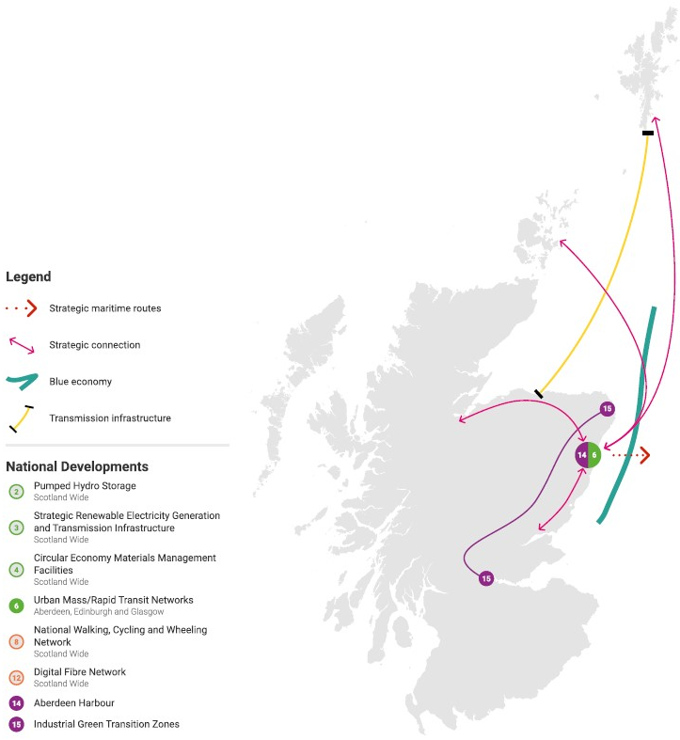
NPF4 Overview
NE Regional Priorities:
  “This part of Scotland will play a crucial role in achieving Just Transition to net zero. By guiding RSS and LDPs in this area, our strategy aims to:
  Plan infrastructure and investment to support the transition from oil and gas to net zero whilst protecting and enhancing blue and green infrastructure and decarbonising connectivity
  Focus on continued regeneration through the principles of local living and 20 minute neighbourhoods to sustain the skilled workforce and improve local liveability
  Support continued economic diversification and innovation.”

Slide 7
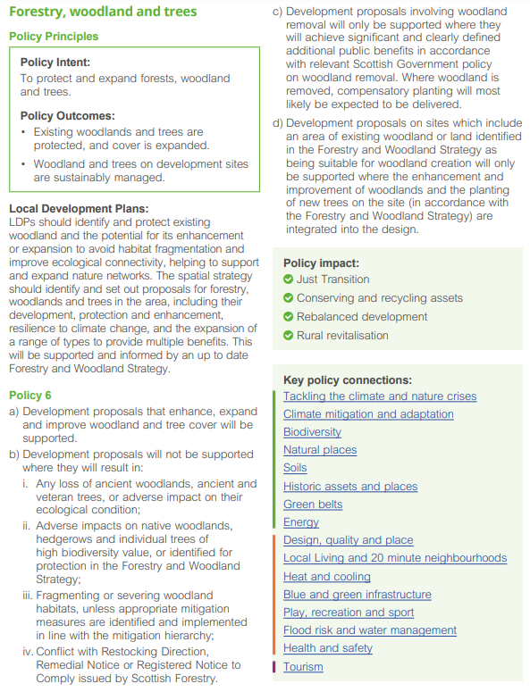
NPF 4 Policies
Part 2 – National Planning Policy
Three themes
- Sustainable Places
- Liveable Places
- Productive Place
Each topic area set out in the same way
  Policy Intent
  Policy Outcome
  Local Development Plan section
  Policy section
  Policy Impact
  Key Policy connections

Slide 8
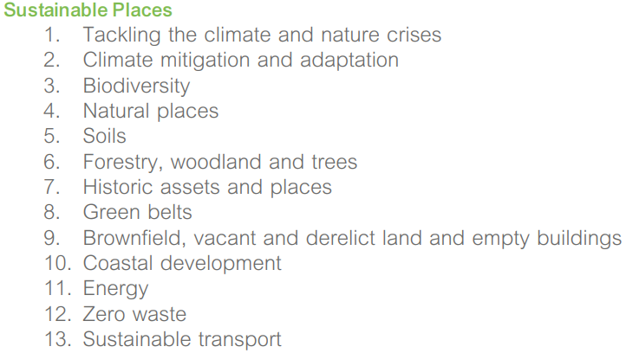
NPF4 Policy Overview
NPF4 should be read as a whole … a package of planning policies to guide us to the place we want Scotland to be in 2045.
Policy 1- When considering all development proposals significant weight will be given to the global climate and nature crises.
Policy 2 - sited and designed to minimise lifecycle greenhouse gas emissions as far as possible; Development proposals will be sited and designed to adapt to current and future risks from climate change.
Policy 3 - the enhancement of biodiversity, including where relevant, restoring degraded habitats and building and strengthening nature networks and the connections between them. Proposals should also integrate nature-based solutions, where possible.

Slide 9
NPF4 Policy Overview
Policy 9 - sustainable reuse, whether permanent or temporary, will be supported. The biodiversity value of brownfield land which has naturalised should be taken into account. Demolition will be regarded as the least preferred option.
Policy 12 - reuse existing buildings and infrastructure; minimise demolition and salvage materials for reuse; minimise waste, reduce pressure on virgin resources and enable building materials, components and products to be disassembled, and reused at the end of their useful life; use materials with the lowest forms of embodied emissions, such as recycled and natural construction materials; use materials that are suitable for reuse with minimal reprocessing.
Notes:
13 polices within the theme -
Where we reduce emissions, restore and better connect biodiversity.
Scotland’s high quality environment, and the natural capital it supports, underpin our approach to tackling climate change and the economy and is fundamental to our health and wellbeing. It provides the essentials we all need to survive, including clean air water and food.
Policy 1-10 Protectionist principle - conserve, restore, enhance, expand , improve, resilience
Managed in a sustainable way - both natural environment and built heritage
Policy 1. new - When considering all development proposals significant weight will be given to the global climate and nature crises. - ALL development proposals – only policy within the document which says this
Key policy connections – All other policies – Policy 1, Policy 2
policy 3: Biodiversity new
Policy 9 – focus on Brownfield – reuse – demolition last resort – use what we have.
Policy 11 – support for renewebals - not at all cost, still criteria to be adhered too
Policy 11 – 13 – Supportive / promotive principle – encourage, promote, facilitate

Slide 10
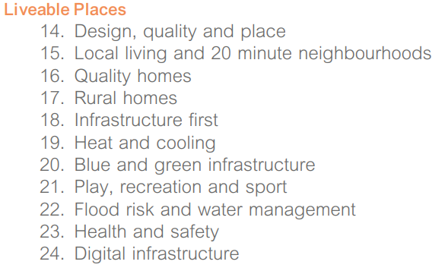
NPF4 Policy Overview
Policy 14 - Healthy: Supporting the prioritisation of women’s safety and improving physical and mental health.
Policy 15 – will contribute to local living including, where relevant, 20 minute neighbourhoods.
Place Principle – Policy 14 and 15.
Policy 16 – Minimum All Tenure Housing Land Requirement - Statement of Community Benefit.

Slide 11
NPF4 Policy Overview
Policy 19 - Connect to a heat network; retrofit to connect to a heat network; be designed to connect to a heat network once one comes along.
Policy 20 - for temporary open space or green space on unused or underused land will be supported. Development proposals that include new or enhanced blue and/or green infrastructure will provide effective management and maintenance plans covering the funding arrangements for their long-term delivery and upkeep, and the party or parties responsible for these.
Notes:
10 Policies within the theme
Where we can all live better, healthier lives
Policy 14-19, 21 – Supportive / promotive principle – encourage, promote, facilitate
Policy 20 - Protectionist principle - protect, enhance, resilience
Quality, sustainability and energy efficiency in homes and place. – making sure there are enough homes, and they and the surrounding area are of good quality – Quality does not stop at the front door – Welcoming and safe places / compact / everything you need for daily living within a short distance from your home preferably by walking, wheeling or cycling or using sustainable transport options, access to blue and green infrasture. Heating and cooling of homes – heat network
Place Principe - All those responsible for providing services and looking after assets in a place need to work and plan together, and with local communities, to improve the lives of people, support inclusive and sustainable economic growth and create more successful places.
Policy 14 – Design, quality and place ( 6 qualities of successful places – healthy (women's safety, physical and mental health)/ pleasant / connected / distinctive / sustainable / adaptable)
Policy 15 – Local living and 20 minute neighbourhoods
Policy 16 – Quality homes (minimum all tenure housing land requirements – phasing short (1-3), medium (4-6), long (7-10) term No longer maintaining a 5 year effective land supply – housing Figures in NATIONAL Doc – not SDPA Statement of Community Benefit.
Policy 17 – Rural homes – not applicable to ACC
Policy 18 – Infrastructure first – New policy area but not for us – looked at infrasture requirements since 2012 plan and land for transport stuff too.
Policy 19 – Heat and cooling
Policy 20 – Blue and green infrastructure
Policy 21 – Play, recreation and sport – Switch from SPP – focus on play (Children) now rather then recreation and sport
Policy 22 – Flood risk and water management (no water abstraction)
Policy 23 – Health and safety – new policy area -
Policy 24 – Digital infrastructure

Slide 12
NPF4 Policy Overview
Policy 21 - new streets and public realm should be inclusive and enable children and young people to play and move around safely and independently, maximising opportunities for informal and incidental play in the neighbourhood.
Policy 23 – Health Impact Assessment.
Policy 23 - will be designed to take into account suicide risk.
Notes:
10 Policies within the theme
Where we can all live better, healthier lives
Policy 14-19, 21 – Supportive / promotive principle – encourage, promote, facilitate
Policy 20 - Protectionist principle - protect, enhance, resilience
Quality, sustainability and energy efficiency in homes and place. – making sure there are enough homes, and they and the surrounding area are of good quality – Quality does not stop at the front door – Welcoming and safe places / compact / everything you need for daily living within a short distance from your home preferably by walking, wheeling or cycling or using sustainable transport options, access to blue and green infrasture. Heating and cooling of homes – heat network
Place Principe - All those responsible for providing services and looking after assets in a place need to work and plan together, and with local communities, to improve the lives of people, support inclusive and sustainable economic growth and create more successful places.
Policy 14 – Design, quality and place ( 6 qualities of successful places – healthy (women's safety, physical and mental health)/ pleasant / connected / distinctive / sustainable / adaptable)
Policy 15 – Local living and 20 minute neighbourhoods
Policy 16 – Quality homes (minimum all tenure housing land requirements – phasing short (1-3), medium (4-6), long (7-10) term No longer maintaining a 5 year effective land supply – housing Figures in NATIONAL Doc – not SDPA Statement of Community Benefit.
Policy 17 – Rural homes – not applicable to ACC
Policy 18 – Infrastructure first – New policy area but not for us – looked at infrasture requirements since 2012 plan and land for transport stuff too.
Policy 19 – Heat and cooling
Policy 20 – Blue and green infrastructure
Policy 21 – Play, recreation and sport – Switch from SPP – focus on play (Children) now rather then recreation and sport
Policy 22 – Flood risk and water management (no water abstraction)
Policy 23 – Health and safety – new policy area -
Policy 24 – Digital infrastructure

Slide 13
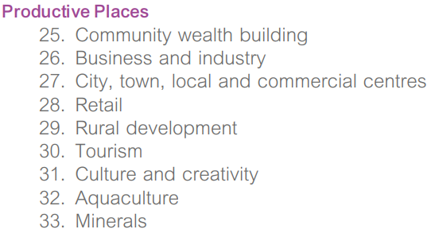
NPF4 Policy Overview
Policy 25 - which contribute to local or regional community wealth building strategies ... improving community resilience and reducing inequalities; increasing spending within communities; ensuring the use of local supply chains and services; local job creation; supporting community led proposals, including creation of new local firms and enabling community led ownership of buildings and assets, community ownership and management of land.
Policy 27 – residential development within city/town centres will be supported.
Policy 30- involve the change of use of a tourism-related facility will only be supported where it is demonstrated that the existing use is no longer viable and that there is no requirement for alternative tourism-related facilities in the area.

Slide 14

NPF4 Policy Overview
Policy 31 - that involve a significant change to existing, or the creation of new, public open spaces will make provision for public art.
Proposals that would result in the loss of an arts or cultural venue will only supported where:
there is no longer a sustainable demand for the venue …; or
the venue, as evidenced by consultation, no longer meets the needs of users and cannot be adapted; or
alternative provision of equal or greater standard is made available at a suitable location within the local area; and
iv. the loss of the venue does not result in loss or damage to assets or objects of significant cultural value.
Notes:
9 polices in the theme
Where we have a greener, fairer and more inclusive wellbeing economy
Policy 25, 26, 27, 28, 29, 30, 31, 32, – Supportive / promotive principle – encourage, promote, facilitate
Policy 33 – sustainable management
Policy 25 – Community wealth building – new policy area - A people-centred approach to local economic development, which redirects wealth back into the local economy, and places control and benefits into the hands of local people
Policy 26 – Business and industry – supported in allocated areas - Major developments for manufacturing or industry will be accompanied by a decarbonisation strategy to demonstrate how greenhouse gas emissions from the process are appropriately abated
Policy 27 – City, town, local and commercial centres – town centre first assessment, city centre living, drive throughs
Policy 28 – Retail Policy
29 – Rural development – not us
Policy 30 – Tourism – expanded – more of a footnote in SPP, policy in NPF4 – short term lets (not supported where impact on local amenity / the economic benefits do not outweigh the loss of residential accommodation
Policy 31 – Culture and Creativity - new ( public art provision, space for workshops,
Policy 32 – Aquaculture - not for us? Oil and gas in National Marine Plan but latest's Gov does not support this - More about food security
Policy 33 – Minerals - fossil fuels generally no – oil and gas, unconventional oil and gas – no, mineral extraction – sustainable extraction

Slide 15
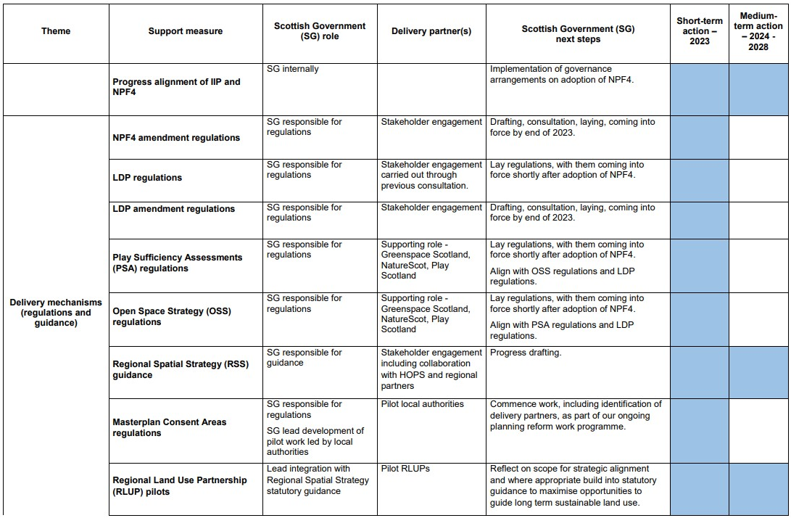
Delivery Mechanisms (Regs & Guidance)

Slide 16
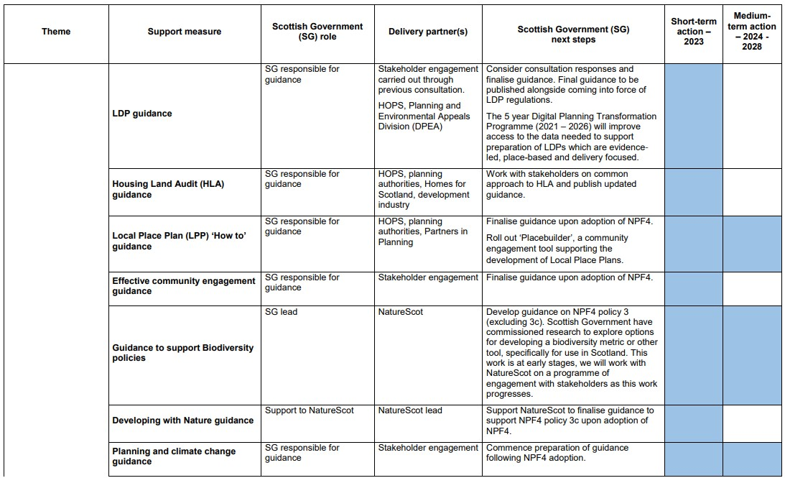
Delivery Mechanisms (Regs & Guidance)

Slide 17
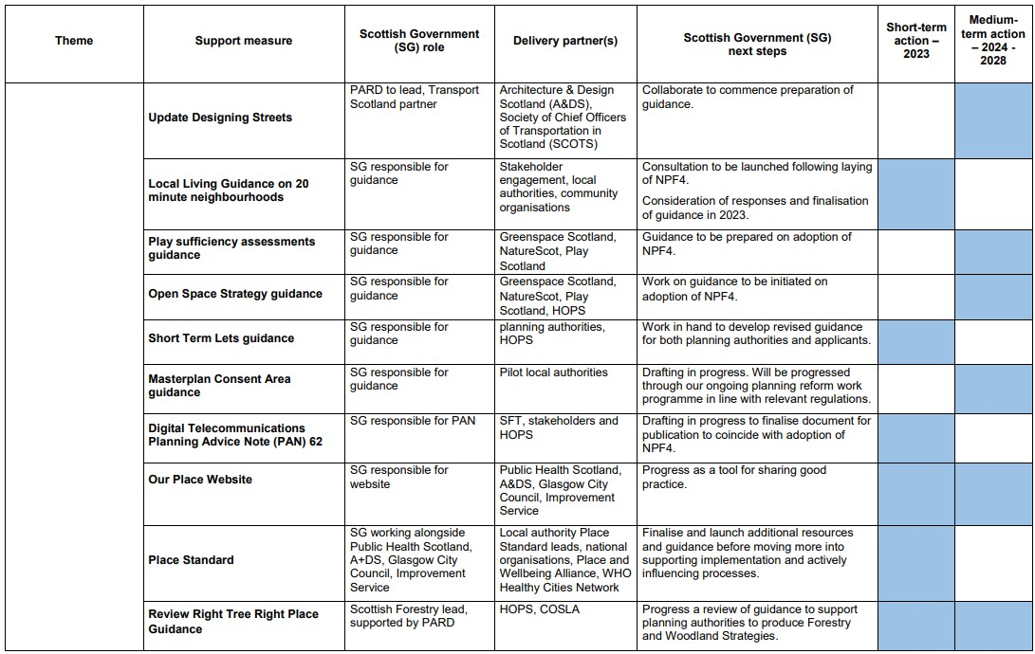
Delivery Mechanisms (Regs & Guidance)

Slide 18
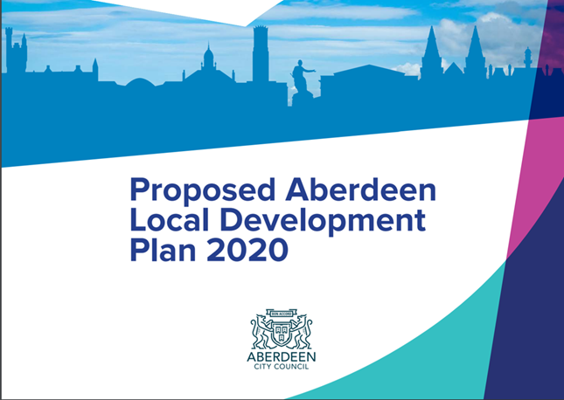
Local Development Plan 2023
It has two parts;
Spatial Strategy
Planning Policies
Important notes
Is a material consideration in determining planning applications.

Slide 19
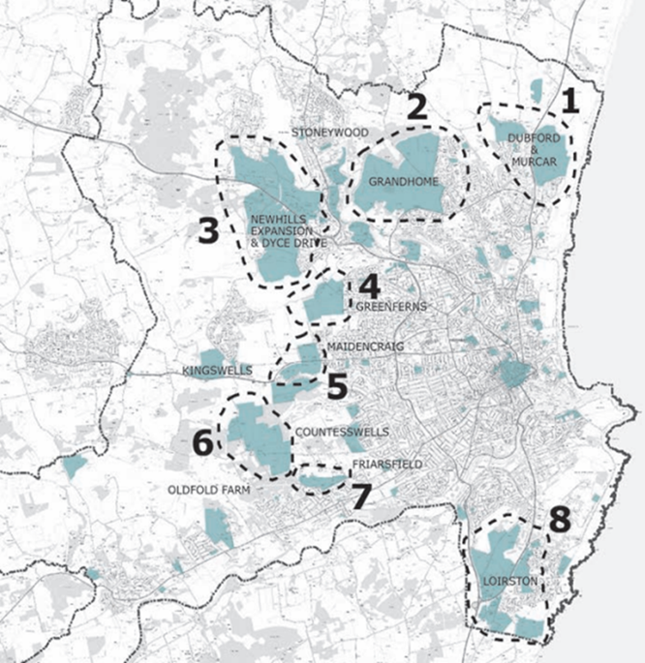
Spatial Strategy
City Centre and Brownfield.
A choice of locations and sizes of developments across the City, mostly contained within the route of the AWPR.
Not just housing development – land identified for jobs and services

Slide 20
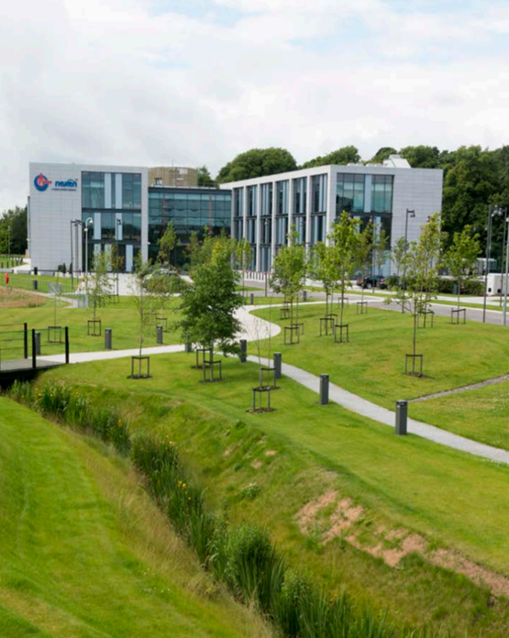
Planning Policies
Health and Wellbeing
Protecting and Enhancing the Natural Environment
Quality Placemaking by Design
Sustainable Use of Resources
Meeting Housing and Community Needs
The Vibrant City
Delivering Infrastructure, Transport and Accessibility
Supporting Business and Industrial Development

Slide 21
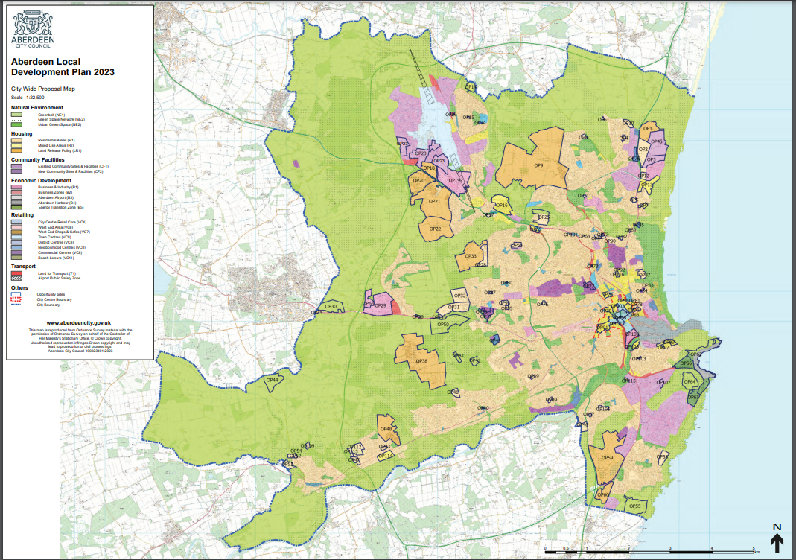
Proposals Map

Slide 22
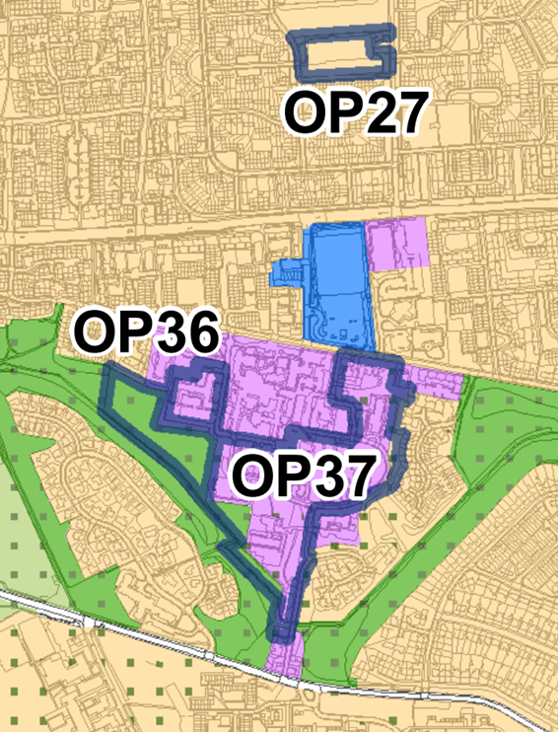
Opportunity Sites in the LDP
Brownfield Sites
OP27 – Greenfern Infant School
OP36 – Charlie House
OP37 - Woodend Hospital
Notes:
OP27 – residential ; OP36 – children’s respite centre and interactive garden area; OP37 – PP

Slide 23
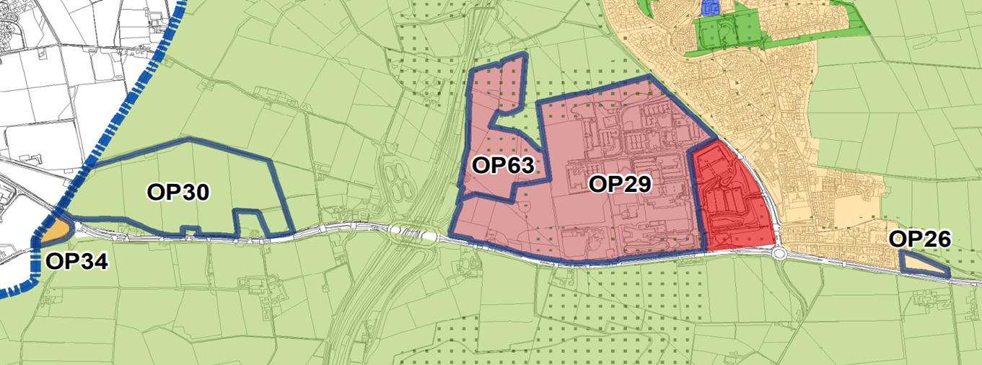
Opportunity Sites in the LDP
OP26 – Housing
OP29 & OP63 – Business Land
OP30 – Stadium and Training Facilities
OP34 – Adjacent to Aberdeenshire Development

Slide 24
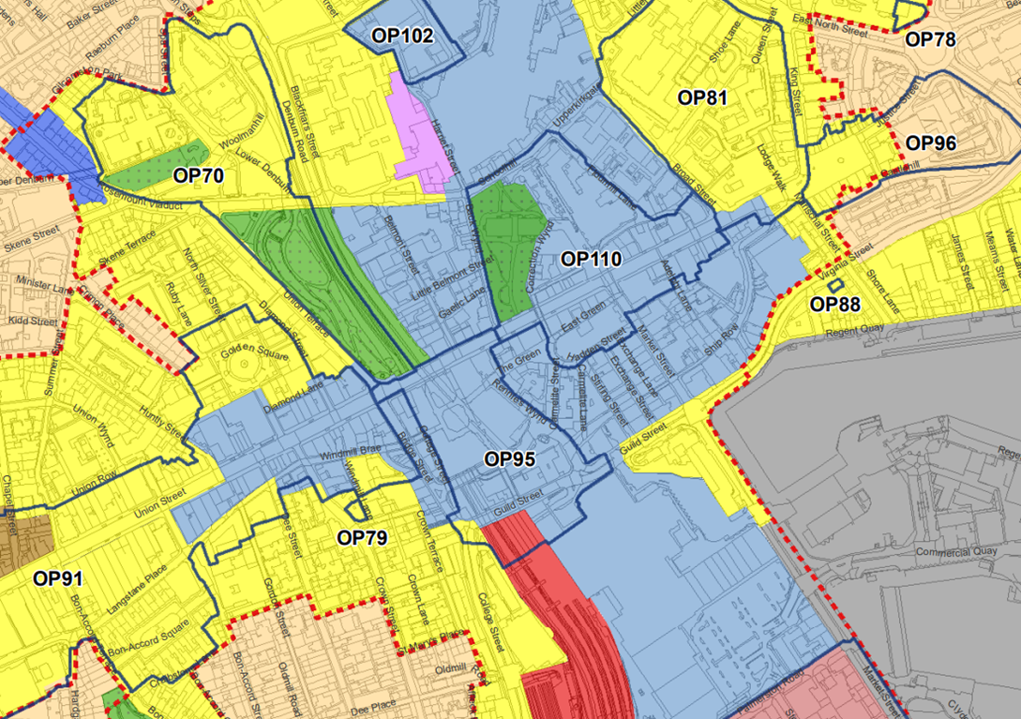
City Centre Masterplan Sites

Slide 25
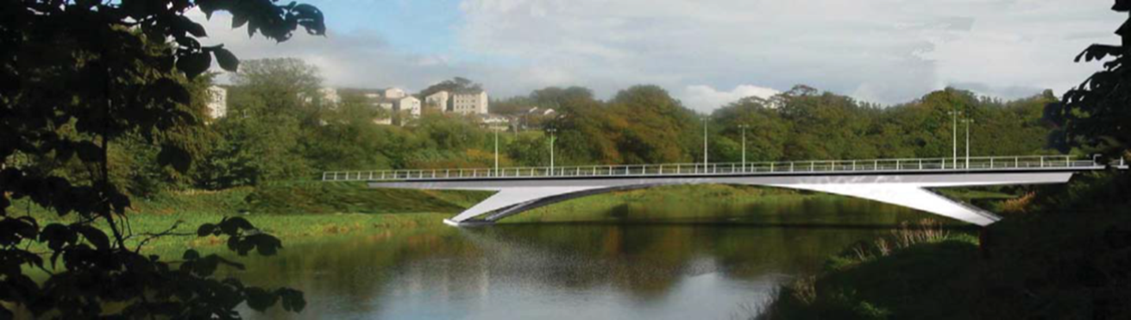
Infrastructure
Transport, Schools, Health, Community Facilities, Green Spaces etc

Slide 26

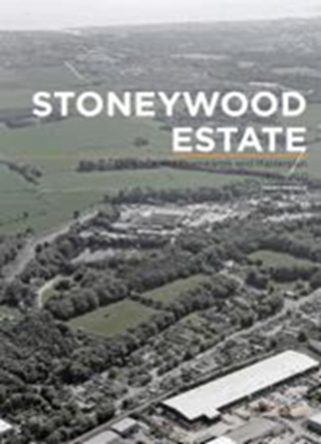
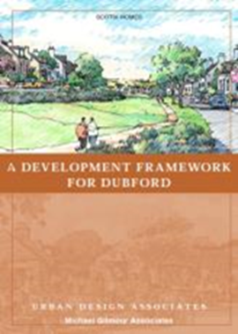
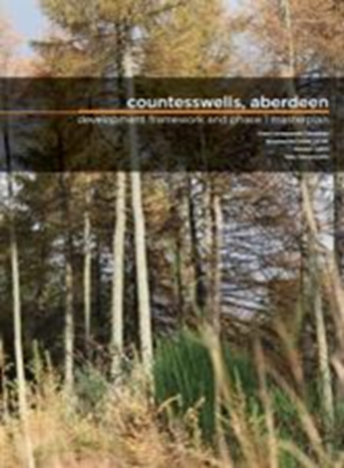

Planning Guidance and Masterplans

Slide 27
NPF4 and ALDP – the relationship
Transition period between two Acts
By 2028 we will be fully under the Planning (Scotland) Act 2019
Incompatibility?
Which has greater weight
Silent areas
Further secondary legislation and guidance
c/o Place and wellbeing: integrating land use planning and public health in Scotland
https://www.improvementservice.org.uk/__data/assets/pdf_file/0029/26876/place-and-wellbeing-integrating-land-use-planning-final.pdf
Notes:
Between two acts – 1997 act main act, 2006 act, and now 2019 act – parts of 2006 act gone
NPF4 adopted on 13 Feb 2023 – “ Our” DP will comprise NPf4 and Aberdeen Local Development Plan until we adopt the 2023 Plan – then it will comprise NPF4 and ALDP 2023
2023 Plan prepared under 2006 act and allowed to be so – if PA had reached Proposed Plan stage by summer 2020 - continue on 2006 act – we were, so did!
So 2023 Plan will be ‘old style’, but next Plan 2028 will be new style.
Incompatibly – don’t envisage much of this. Policies follow same principles on the whole. If there is, doc approved latterly is the primary.
Secondary legislation and guidance to come – including transitional arrangements
Silent areas – which ever doc talks about it is the doc to look at – drive throughs (NPF) / water abstraction (LDP)

Slide 28
Aberdeen Local Development Plan 2028 - Timeline
Development Plan Scheme July 2023
Stage 1 Evidence Report Q2 2023 – Q3 2024
(July-September 2023 to October-December 2024)
Stage 2 Gate Check / Call for Ideas Q3 2024 – Q1 2025
(October-December 2024 to April-June 2025)
Stage 3 Proposed Plan Preparation Q1 2025 – Q1 2026
(April-June 2025 to April-June 26)
Stage 4 Consultation and Modifications Q1 2026 – Q1 2027
(April-June 2026 to April-June 2027)
Stage 5 Examination and Adoption Q1 2027 – Q1 2028
(April-June 2027 to April-June 2028)

Slide 29
Any Questions?
David Berry – dberry@aberdeencity.gov.uk
Donna Laing – dlaing@aberdeencity.gov.uk
LDP team - LDP@aberdeencity.gov.uk

